Slide 1


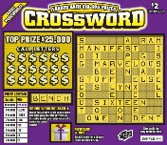


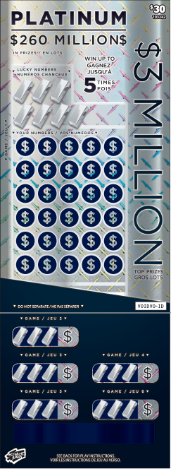
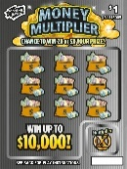



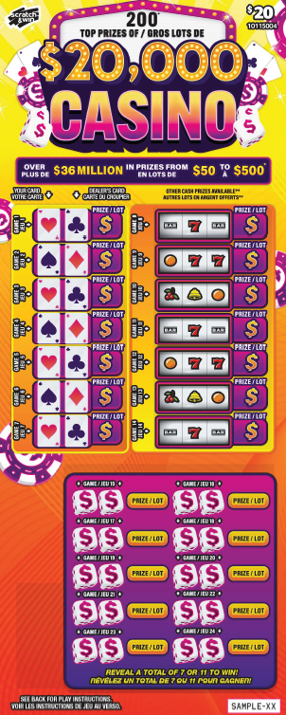
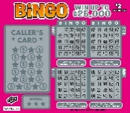

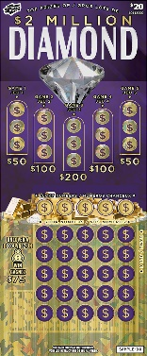
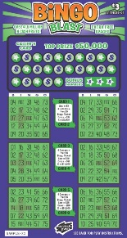

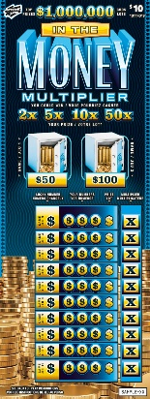
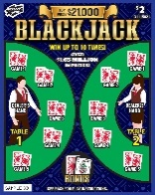
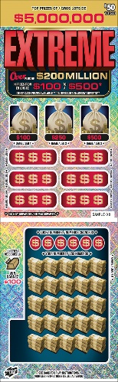


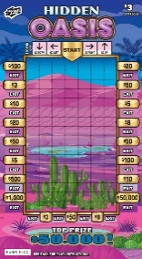

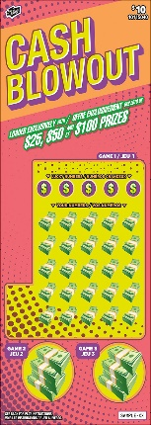
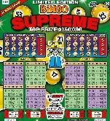
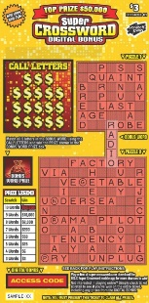
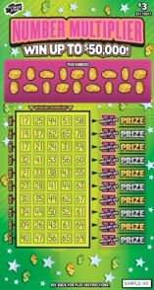

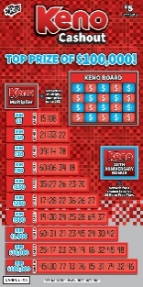
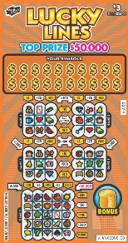
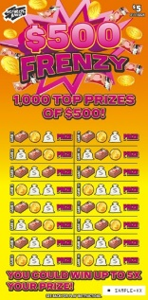

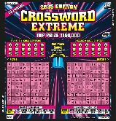
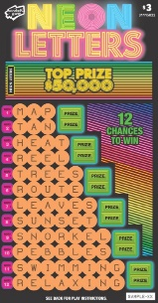

SCRATCH & WIN DISPLAY CASE PLANOGRAM
2-Part Built-In Display Case Planogram
Shoppers Drug Mart | September 2025
Tickets in display may vary depending on location.
Tickets in display may vary depending on location.
Tickets in display may vary depending on location.
Tickets in display may vary depending on location.
Tickets in display may vary depending on location.
Cash Register
Display Strip
Tips for Sales Success:
Organize your tray as shown – it’s designed to give more space to high-value tickets.
Merchandize your high-value tickets closest to the cash register.
Do not put anything on top of the display case, especially covering high-value tickets.
Leave some pockets empty so that you can allow the ticket visuals to show when overlapped.
Always keep your case fully merchandised.
Prevent out-of-stocks – call Hotline to place an emergency order between call days if needed.
REMINDER
An empty case means lost sales

Slide 2
SCRATCH & WIN DISPLAY CASE PLANOGRAM
2-Part Built-In Display Case Planogram
Shoppers Drug Mart | September 2025
Tickets in display may vary depending on location.
$1
Gold Rush
$1
$1
$1
Tickets in display may vary depending on location.
Pocket 9
empty
empty
empty
empty
empty
empty
Tickets in display may vary depending on location.
$2
Crossword
Tickets in display may vary depending on location.
empty
empty
empty
$2
$2
$2
Pocket 8
empty
Tickets in display may vary depending on location.
$2 Bingo
empty
empty
Cash Register
Pocket 7
$2 Blackjack
$3 Bingo
$5 Bingo
empty
empty
Pocket 6
empty
empty
empty
empty
empty
empty
empty
empty
Pocket 5
empty
empty
$10
Bingo
$10
Crossword
empty
empty
empty
empty
Pocket 4
empty
empty
$5
Crossword
$10
empty
$5
empty
empty
Pocket 3
$3
Crossword
empty
empty
empty
empty
empty
$10
$20
Pocket 2
$3
Lucky Lines
$5
$5
Set for Life
empty
empty
empty
empty
empty
Pocket 1
$3
$5
$20 Wide
$30
$3
$5
$10
$20
Display Strip
Tips for Sales Success:
Organize your tray as shown – it’s designed to give more space to high-value tickets.
Merchandize your high-value tickets closest to the cash register.
Do not put anything on top of the display case, especially covering high-value tickets.
Leave some pockets empty so that you can allow the ticket visuals to show when overlapped.
Always keep your case fully merchandised.
Prevent out-of-stocks – call Hotline to place an emergency order between call days if needed.
REMINDER
An empty case means lost sales

Slide 3
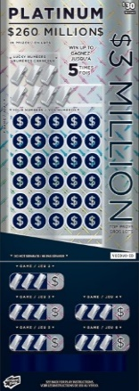

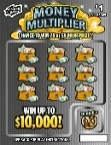


SCRATCH & WIN DISPLAY CASE PLANOGRAM
2-Part Built-In Display Case Planogram
Shoppers Drug Mart | September 2025
Tickets in display may vary depending on location.
Tickets in display may vary depending on location.
Tickets in display may vary depending on location.
Tickets in display may vary depending on location.
Tickets in display may vary depending on location.
Cash Register
Display Strip
Tips for Sales Success:
Organize your tray as shown – it’s designed to give more space to high-value tickets.
Merchandize your high-value tickets closest to the cash register.
Do not put anything on top of the display case, especially covering high-value tickets.
Leave some pockets empty so that you can allow the ticket visuals to show when overlapped.
Always keep your case fully merchandised.
Prevent out-of-stocks – call Hotline to place an emergency order between call days if needed.
REMINDER
An empty case means lost sales

Slide 4
SCRATCH & WIN DISPLAY CASE PLANOGRAM
2-Part Built-In Display Case Planogram
Shoppers Drug Mart | September 2025
Tickets in display may vary depending on location.
Tickets in display may vary depending on location.
$1
Gold Rush
Tickets in display may vary depending on location.
$1
$1
Tickets in display may vary depending on location.
empty
empty
empty
empty
empty
empty
empty
empty
empty
Tickets in display may vary depending on location.
Cash Register
empty
empty
empty
empty
empty
empty
$2
$2 Bingo
$3 Bingo
empty
empty
$2
Blackjack
empty
empty
empty
empty
empty
$2
empty
empty
empty
empty
$2
XW
$3
Lucky Lines
$5
Bingo
$5
XW
$5
Set
For Life
$5
$10
XW
$20
$10
$20
$10
$2
$3
$3
$5
$5
$10
$20
(Wide)
$3 XW
$30
$10
Bingo
Display Strip
Tips for Sales Success:
Organize your tray as shown – it’s designed to give more space to high-value tickets.
Merchandize your high-value tickets closest to the cash register.
Do not put anything on top of the display case, especially covering high-value tickets.
Leave some pockets empty so that you can allow the ticket visuals to show when overlapped.
Always keep your case fully merchandised.
Prevent out-of-stocks – call Hotline to place an emergency order between call days if needed.
REMINDER
An empty case means lost sales

Slide 5

SCRATCH & WIN DISPLAY CASE PLANOGRAM
3-Part Built-In Display Case Planogram
Shoppers Drug Mart | September 2025
Pocket 4
Tickets in display may vary depending on location.
Tickets in display may vary depending on location.
Pocket 3
Tickets in display may vary depending on location.
Tickets in display may vary depending on location.
Cash Register
Pocket 2
Pocket 1
Display Strip
Tips for Sales Success:
Organize your tray as shown – it’s designed to give more space to high-value tickets.
Merchandize your high-value tickets closest to the cash register.
Do not put anything on top of the display case, especially covering high-value tickets.
Leave some pockets empty so that you can allow the ticket visuals to show when overlapped.
Always keep your case fully merchandised.
Prevent out-of-stocks – call Hotline to place an emergency order between call days if needed.
REMINDER
An empty case means lost sales

Slide 6
SCRATCH & WIN DISPLAY CASE PLANOGRAM
3-Part Built-In Display Case Planogram
Shoppers Drug Mart | September 2025
$1
Gold
Rush
Pocket 4
$2
empty
empty
empty
empty
empty
$1
$1
$2
$2
$2
Blackjack
Pocket 3
$2
Crossword
$2
Bingo
$3
Crossword
empty
empty
empty
empty
$2
$2
empty
empty
Cash Register
Pocket 2
$3
empty
$3
Lucky Lines
$5
Bingo
$5
Crossword
$10
Bingo
$10
Crossword
$3
Bingo
empty
empty
empty
Pocket 1
$5
Set for
Life
$20
$3
$3
$5
$10
$10
$20
Wide
$30
$5
$5
$10
$20
Display Strip
Tips for Sales Success:
Organize your tray as shown – it’s designed to give more space to high-value tickets.
Merchandize your high-value tickets closest to the cash register.
Do not put anything on top of the display case, especially covering high-value tickets.
Leave some pockets empty so that you can allow the ticket visuals to show when overlapped.
Always keep your case fully merchandised.
Prevent out-of-stocks – call Hotline to place an emergency order between call days if needed.
REMINDER
An empty case means lost sales

