Slide 1

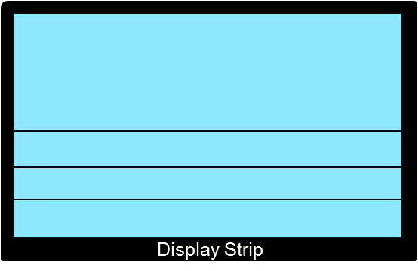
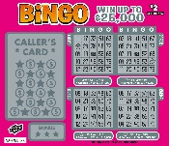


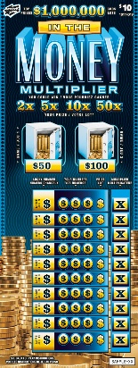

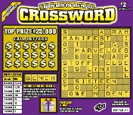

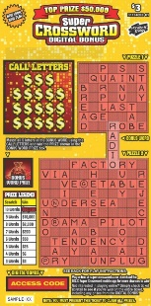



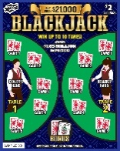
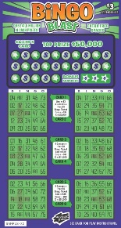

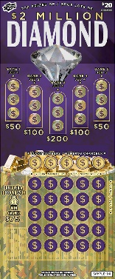
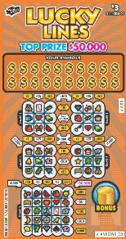
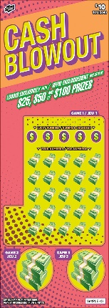


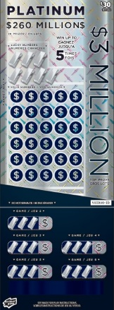
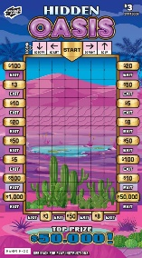
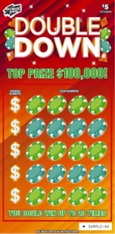
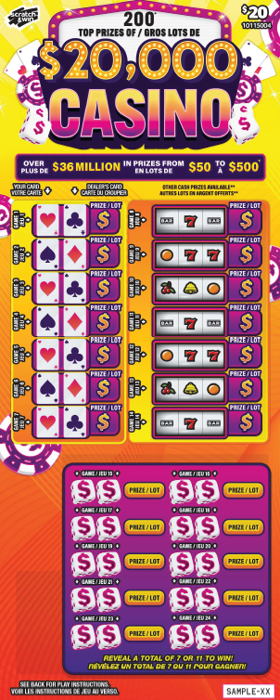
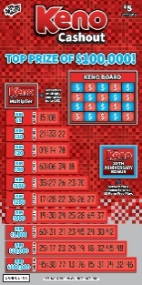
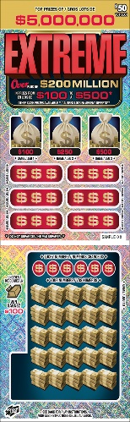
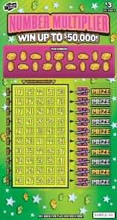
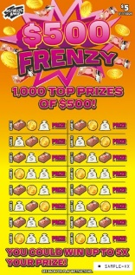
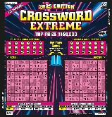
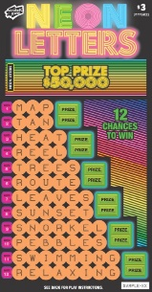
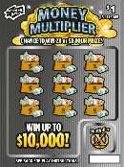

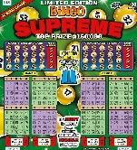


SCRATCH & WIN DISPLAY CASE PLANOGRAM
Built-In Display Case Planogram
Shoppers Drug Mart | September 2025
CRITICAL
Tickets in display may vary depending on location.
Tickets in display may vary depending on location.
Tickets in display may vary depending on location.
Tickets in display may vary depending on location.
Tickets in display may vary depending on location.
Cash Register
Tips for Sales Success:
Organize your tray as shown – it’s designed to give more space to high-value tickets.
Merchandize your high-value tickets closest to the cash register.
Do not put anything on top of the display case, especially covering high-value tickets.
Leave some pockets empty so that you can allow the ticket visuals to show when overlapped
Always keep your case fully merchandised.
Prevent out-of-stocks – call Hotline to place an emergency order between call days if needed.

Slide 2
SCRATCH & WIN DISPLAY CASE PLANOGRAM
Built-In Display Case Planogram
Shoppers Drug Mart | September 2025
CRITICAL
Tickets in display may vary depending on location.
Tickets in display may vary depending on location.
$10 XWrd/ $10 Bingo
$2 XWrd/ $2 Bingo/ $1 GoldRush
$20 Regional
$5 XWrd/ SFL/ $10 National
Tips for Sales Success:
Organize your tray as shown – it’s designed to give more space to high-value tickets.
Merchandize your high-value tickets closest to the cash register.
Do not put anything on top of the display case, especially covering high-value tickets.
Leave some pockets empty so that you can allow the ticket visuals to show when overlapped
Always keep your case fully merchandised.
Prevent out-of-stocks – call Hotline to place an emergency order between call days if needed.
$3 XWrd
Cash Register
$2 BlackJack
$5 New Ticket/ $10 National
$5 N/ $3 N/ $2 N
$5
$3- Lucky Lines/ $3 Bingo/$2 N $5 Bingo $30
$3 New Ticket/ $1 New Ticket/ $1 New Ticket
$2 New Ticket/ $20 $10 Regional

