Slide 1

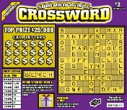


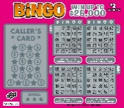
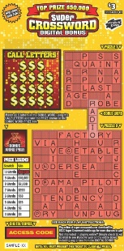


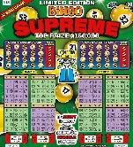
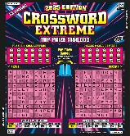

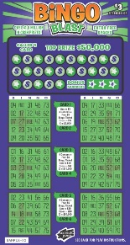
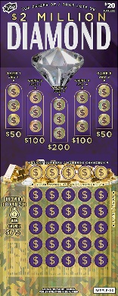




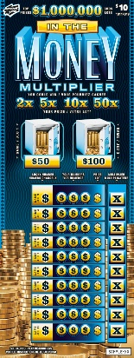
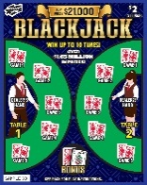
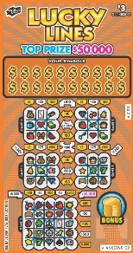



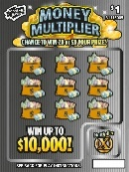
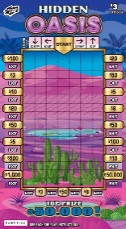
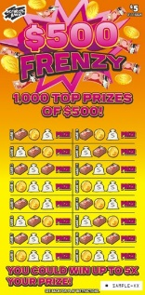
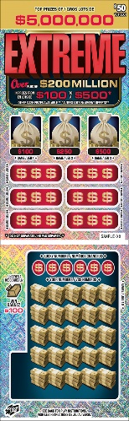

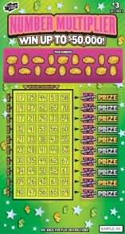
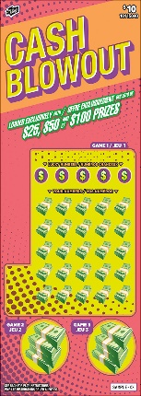
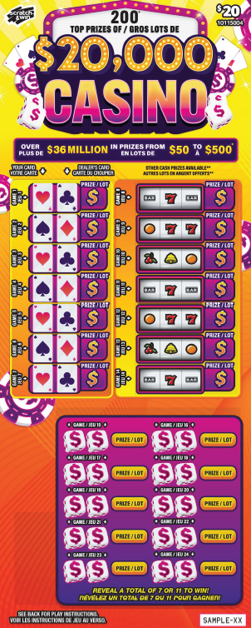


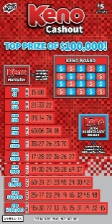
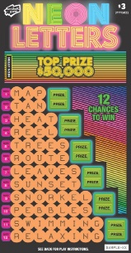


SCRATCH & WIN DISPLAY CASE PLANOGRAM
4-part case, cash register on RIGHT side - Strategic Layout
Retail Network | September 2025
Sleeve 1
Sleeve 2
Sleeve 3
Sleeve 4
The “Power L”
Display new tickets across the front to maximize awareness.
Keep high-value tickets closest to the cash register.
Incorporate tickets you may have that are not on the Planogram according to price point.
Pocket 7
Pocket 6
Pocket 5
Cash Register
Pocket 4
Tips for Sales Success
To maximize sales, don’t put anything on top of the display case, especially covering high-value tickets.
Always keep your case fully stocked. Every time you run out of stock you lose potential sales.
Use the lock feature on the display case door so tickets are secure at all times.
Pocket 3
Pocket 2
Pocket 1
Display Case Strip
* Does not apply to Retail Stores Group accounts.

Slide 2

SCRATCH & WIN DISPLAY CASE PLANOGRAM
4-part case, cash register on RIGHT side - Strategic Layout
Retail Network | September 2025
Sleeve 1
Sleeve 2
Sleeve 3
Sleeve 4
The “Power L”
Display new tickets across the front to maximize awareness.
Keep high-value tickets closest to the cash register.
Incorporate tickets you may have that are not on the Planogram according to price point.
Base Games
Gold Rush, Blackjack, Lucky Lines, Set for Life, Bingo, Crossword
$20
Pocket 7
Pocket 6
Pocket 5
Cash Register
Pocket 4
$1
$3
$5
$10
Tips for Sales Success
To maximize sales, don’t put anything on top of the display case, especially covering high-value tickets.
Always keep your case fully stocked. Every time you run out of stock you lose potential sales.
Use the lock feature on the display case door so tickets are secure at all times.
$10
$30
$2
$30 / $50
Pocket 3
Pocket 2
Pocket 1
Display Case Strip
* Does not apply to Retail Stores Group accounts.

