Slide 1

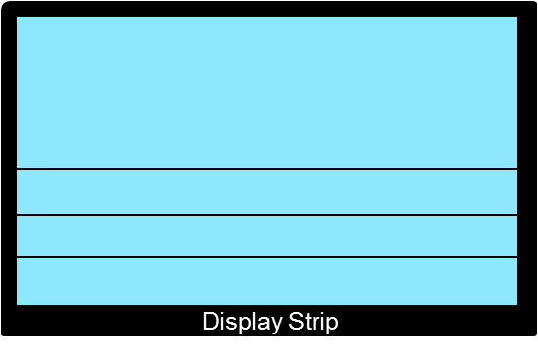

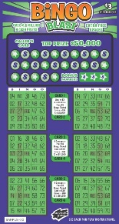
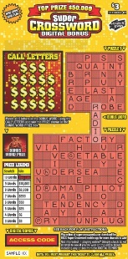


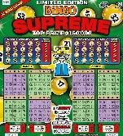

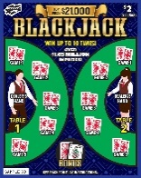


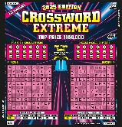

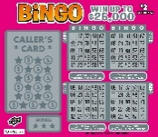
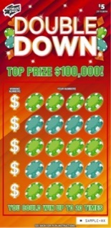
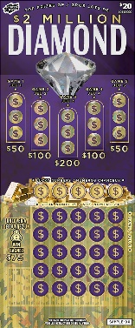
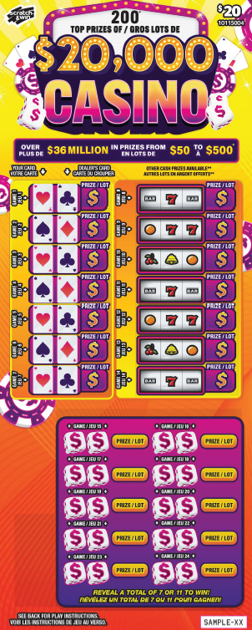

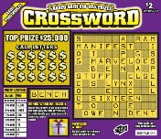
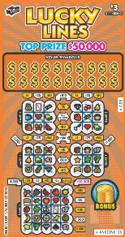

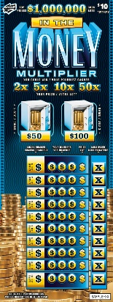
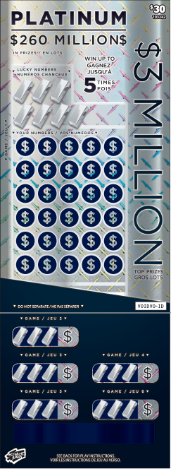
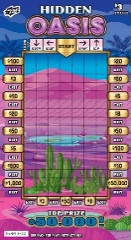
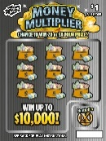
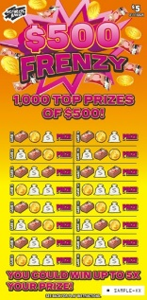
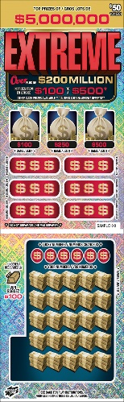
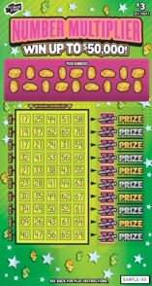
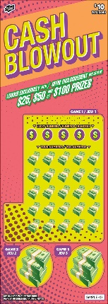

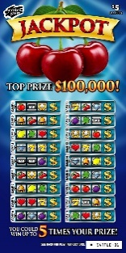

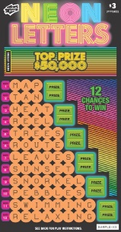
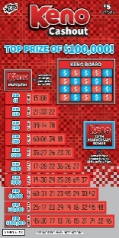


SCRATCH & WIN DISPLAY CASE PLANOGRAM
Built-In Display Case Planogram
London Drugs| September 2025
CRITICAL
Tickets in display may vary depending on location.
Tickets in display may vary depending on location.
Tickets in display may vary depending on location.
Tickets in display may vary depending on location.
Tickets in display may vary depending on location.
Cash Register
Tips for Sales Success:
Organize your tray as shown – it’s designed to give more space to high-value tickets.
Merchandize your high-value tickets closest to the cash register.
Do not put anything on top of the display case, especially covering high-value tickets.
Leave some pockets empty so that you can allow the ticket visuals to show when overlapped
Always keep your case fully merchandised.

Slide 2
SCRATCH & WIN DISPLAY CASE PLANOGRAM
Built-In Display Case Planogram
London Drugs| September 2025
CRITICAL
$1 Gold Rush
$3
Bingo
$3
XWord
$10
Bingo
$10
XWord
$20
Tickets in display may vary depending on location.
$2 Blackjack
$5 Bingo
$5 XWord
$5 SFL
$2 Bingo
Cash Register
$2 XWord
$10 National
Tips for Sales Success:
Organize your tray as shown – it’s designed to give more space to high-value tickets.
Merchandize your high-value tickets closest to the cash register.
Do not put anything on top of the display case, especially covering high-value tickets.
Leave some pockets empty so that you can allow the ticket visuals to show when overlapped
Always keep your case fully merchandised.
$3 Lucky
Lines
$20 National
$2
$5
$1
$3
$10
$30 National

